Slide 1
Neural Network Viz & Generalization
CS8803 Project Final
Shangru Yi (syi73)
2020.04.21 – Final

Slide 2
Background & Motivation
System Abstraction
NN Model Abstraction
Heterogeneous Programming
Interface Abstraction
ML Life Cycle
Model Generation
Project Timeline
DataFlow
Relational Graph
Case Illustration
Invariant Checker
Implementation Timeline
Status Update & Reflections
Future Extension
Generality & Easiness
Notes:
Ashier

Slide 3
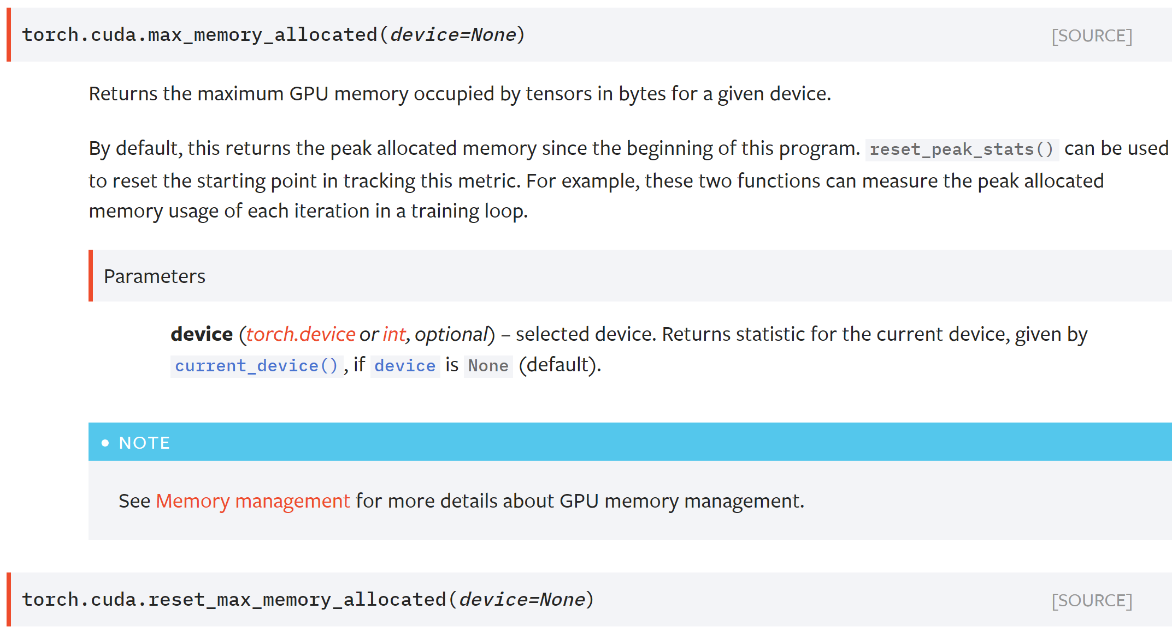
Problem Introduction
Metric Monitoring in Model Level
No clue about underlying metrics
What can we improve?

Slide 4
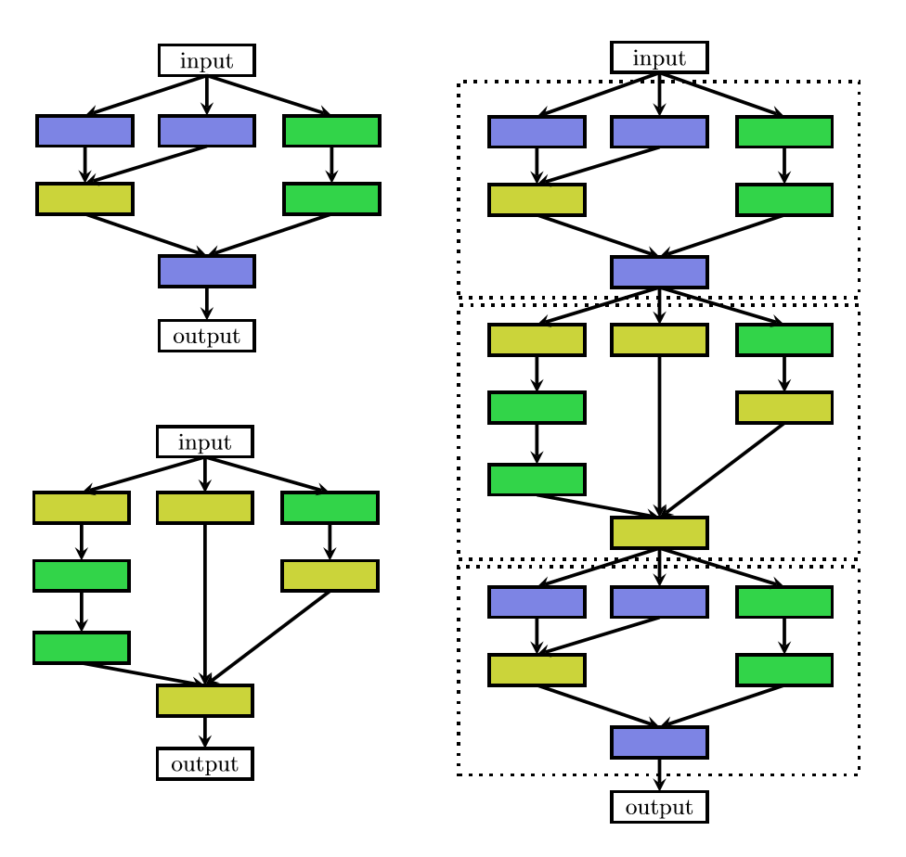
Problem Introduction
Layer -> Model
Layer -> Block ->Model
What can we improve?

Slide 5
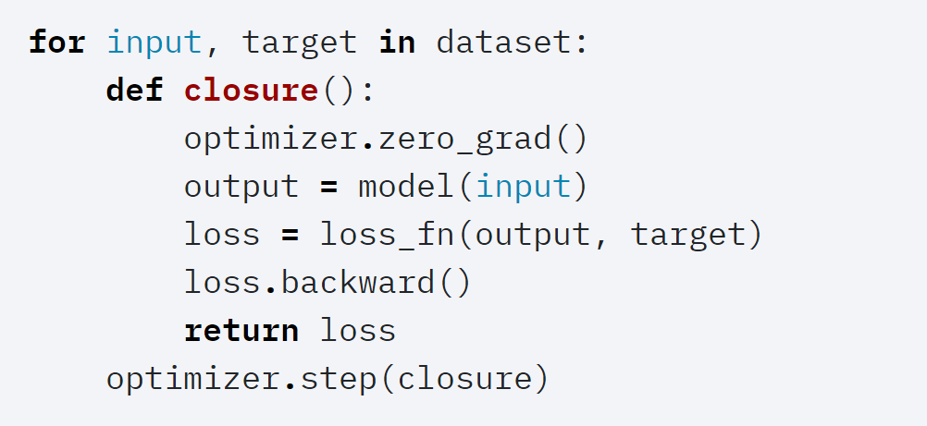
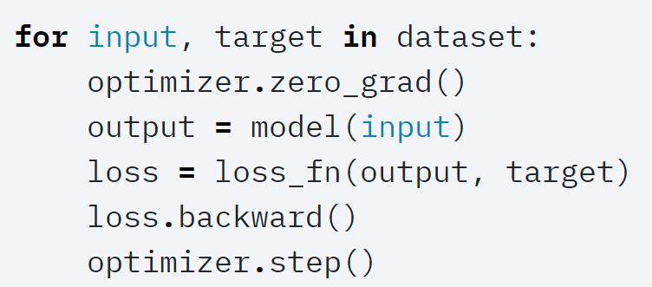
Problem Introduction
Heterogenous Programming
What can we improve?

Slide 6
Problem Introduction
State-of-art Summary
Low level generalization & abstraction
Brief on-training metrics monitoring with visualization
Not combination with current mainstream platforms
Traditional machine learning (Not NN)
Lack of model structure visualization

Slide 7
What is Expected?
Above layer Abstraction
Code Reusage
Readable Structed Programming
Combination with Current Platforms
Metric Monitoring with refined granularity
Falsifiable Hypothesis
Visualized programming for neural network are achievable.
A unified representation format for cross-platform is possible
Above-layer abstraction can speedup construction and improve re-usage.
Higher level debugging with possible hardware assignment can be solved in an easy way with visualization.

Slide 8
ML Life Cycle
Define the neural network that has some learnable parameters
Load pretrained parameters
Iterate over a dataset of inputs
Process the input through the network
Compute the loss to a scalar
Propagate gradients back into the network's parameters
Update the weights of the network, optimizer for update
After iteration, there might be additional operation for the generated parameters, i.e. saving, post-processing

Slide 9
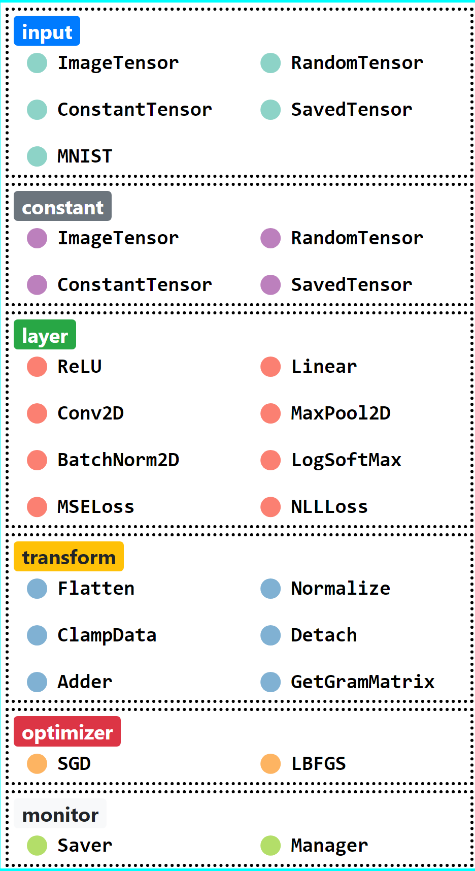
System Abstraction
Abstraction (model, block, layer, ...):
1. Model (blocks)
2. Block (layer nodes)
3. Node link for tensor forwarding
4. Node (layer, optimizer, monitor, …)
5. Tensor (wrapper for PyTorch tensor) with memory usage and naming support

Slide 10
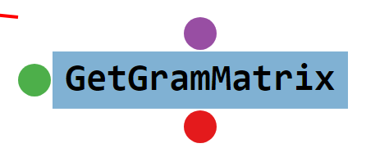
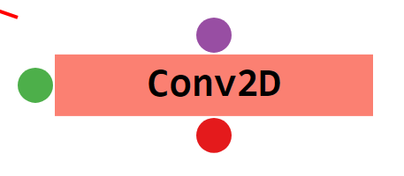
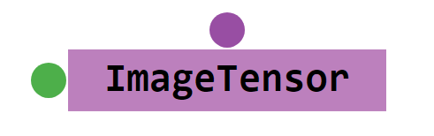
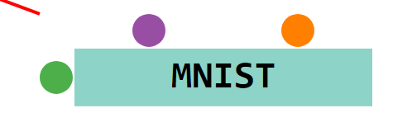
System Abstraction
A node is the wrapper for layer, input, transform, with support for multiple output (the multiple outputs are the deep copy of the first output tensor).
Transform: a transform node is constructed by a transform function
Layer: a layer node is constructed by a layer function
Constant: for some system tensor (e.g. data path for tensor load, constant tensor).
4. Input: a special case for constant node with batching support – link with iteration.
For example, we currently support MNIST (image, label). The input node for MNIST will have two output, one for image and one for corresponding label.

Slide 11
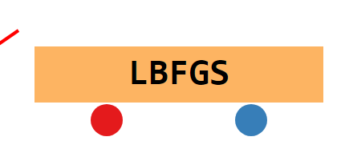
System Abstraction
Optimizer:
Block and node can register in the optimizer for auto gradient update.
For block registration, the parameters of inner layer will be added for gradient update.
For node registration, the tensor in node will be added for gradient update. In order to perform gradient update, a loss function taking tensors for loss measure is required.

Slide 12
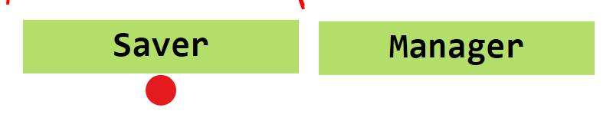
System Abstraction
Monitor:
Monitor is for epoch check and possible model save. We currently support epoch-based model saver.
Manager records the epoch and device to use.
Once the epoch is finish, the tensor linked with saver will be saved.

Slide 13
Life Cycle for Parameter (tensor)
Source:
Imported from local (dataset)
Some constant tensors (zeros, constant)
Operations (transform, layer operation)
Output
Optimizer
Conv2d
Relational Graph Generation
Linear
DAG
Topology Generation
Input
Start from the input node, since we make a constraints that there is only one input node per model. We believe this is proper, since one input is enough, while others can be generated through operation or constant

Slide 14
System Architecture
Backend Starts
Construct Network
Structures
Model Generation
Generate API
(node parameters)
Check Invariants
Whether a tracked tensor is leaf node
Saver for not final tensor
(inplace forward – update input to output)
Model Parse
Code Generation
Model Running
Iteration Memory Usage

Slide 15



Our Solutions
Flask + D3
PyTorch
Front end visualization
User interactions
Input & output
Bind PyTorch function and argument
Parse parameter to formatted model file and readable programming file
Parse exported model files for further changes
On-training monitoring
Parsing generated model
API provider

Slide 16

Our Trials
Not Support for block-wise monitoring at all
Get GPU usage by directly calling Nvidia SMI
Fix format for model feeding
Limited layer support without extension possibility (relu, conv2d, batchNorm)
Just for GPU usage monitoring
Relative complex front-back communication
System abstraction and type wrapper
Previous design doesn’t consider the possible duplicate behavior (just output one tensor) – wrapping the underlying function in an upper object

Slide 17
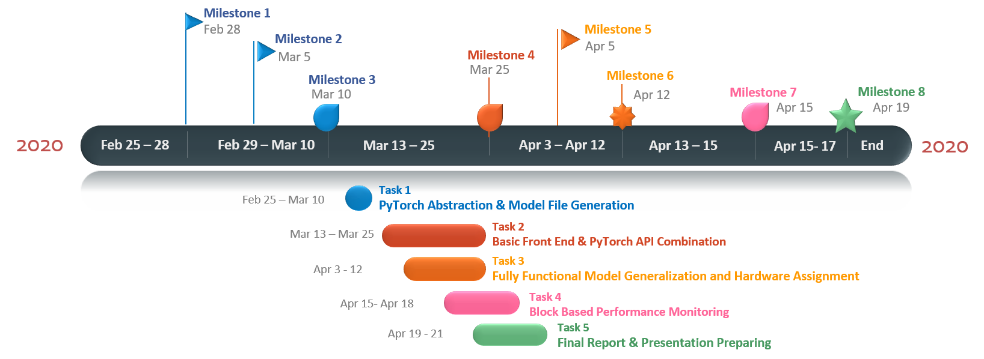
Project Timeline
Once finish the VGG import …

Slide 18
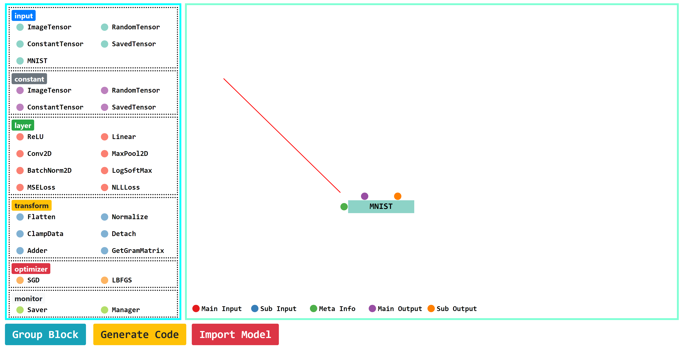
Status Update & Future Extension
Front end visualization and Interaction

Slide 19
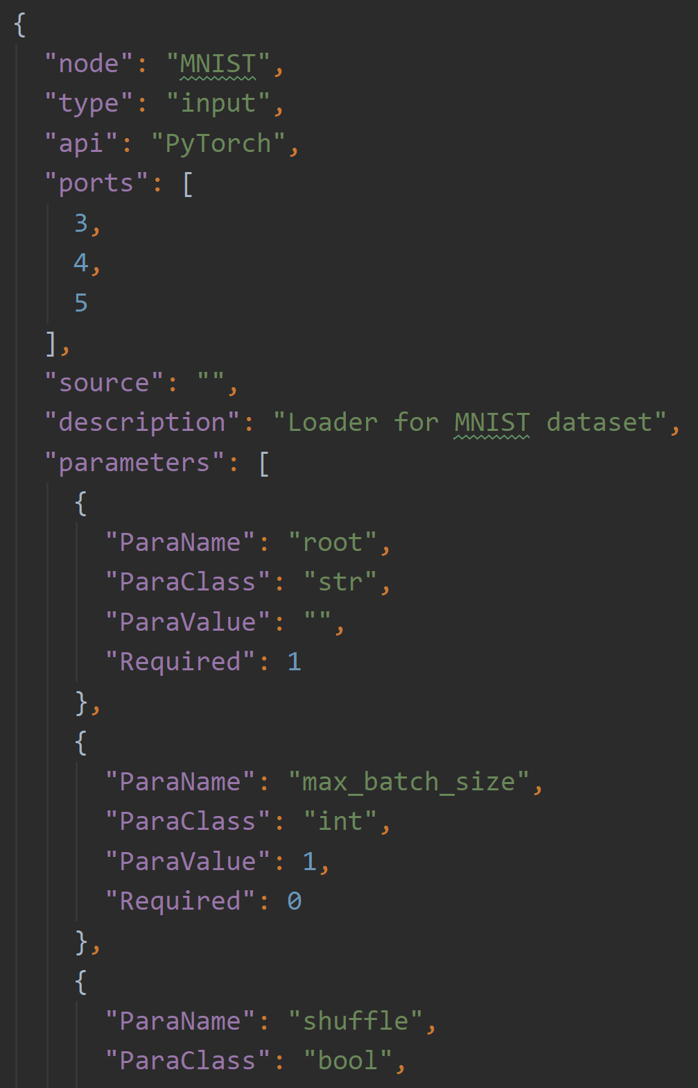
Status Update & Future Extension
Front end visualization and Interaction
Wrapped communication API
Bind PyTorch function and argument

Slide 20
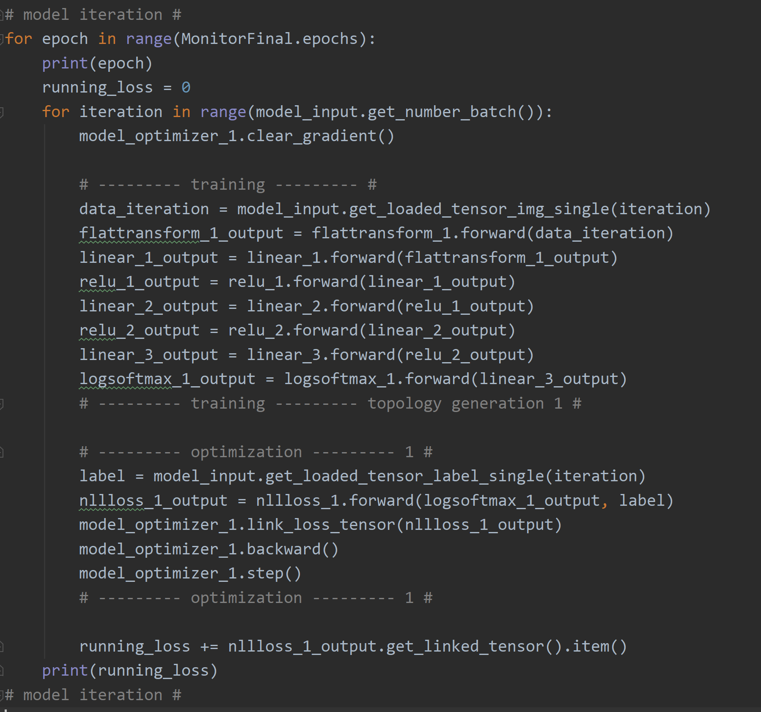
Status Update & Future Extension
Front end visualization and Interaction
Wrapped communication API
Bind PyTorch function and argument
Backend code generation and model running

Slide 21
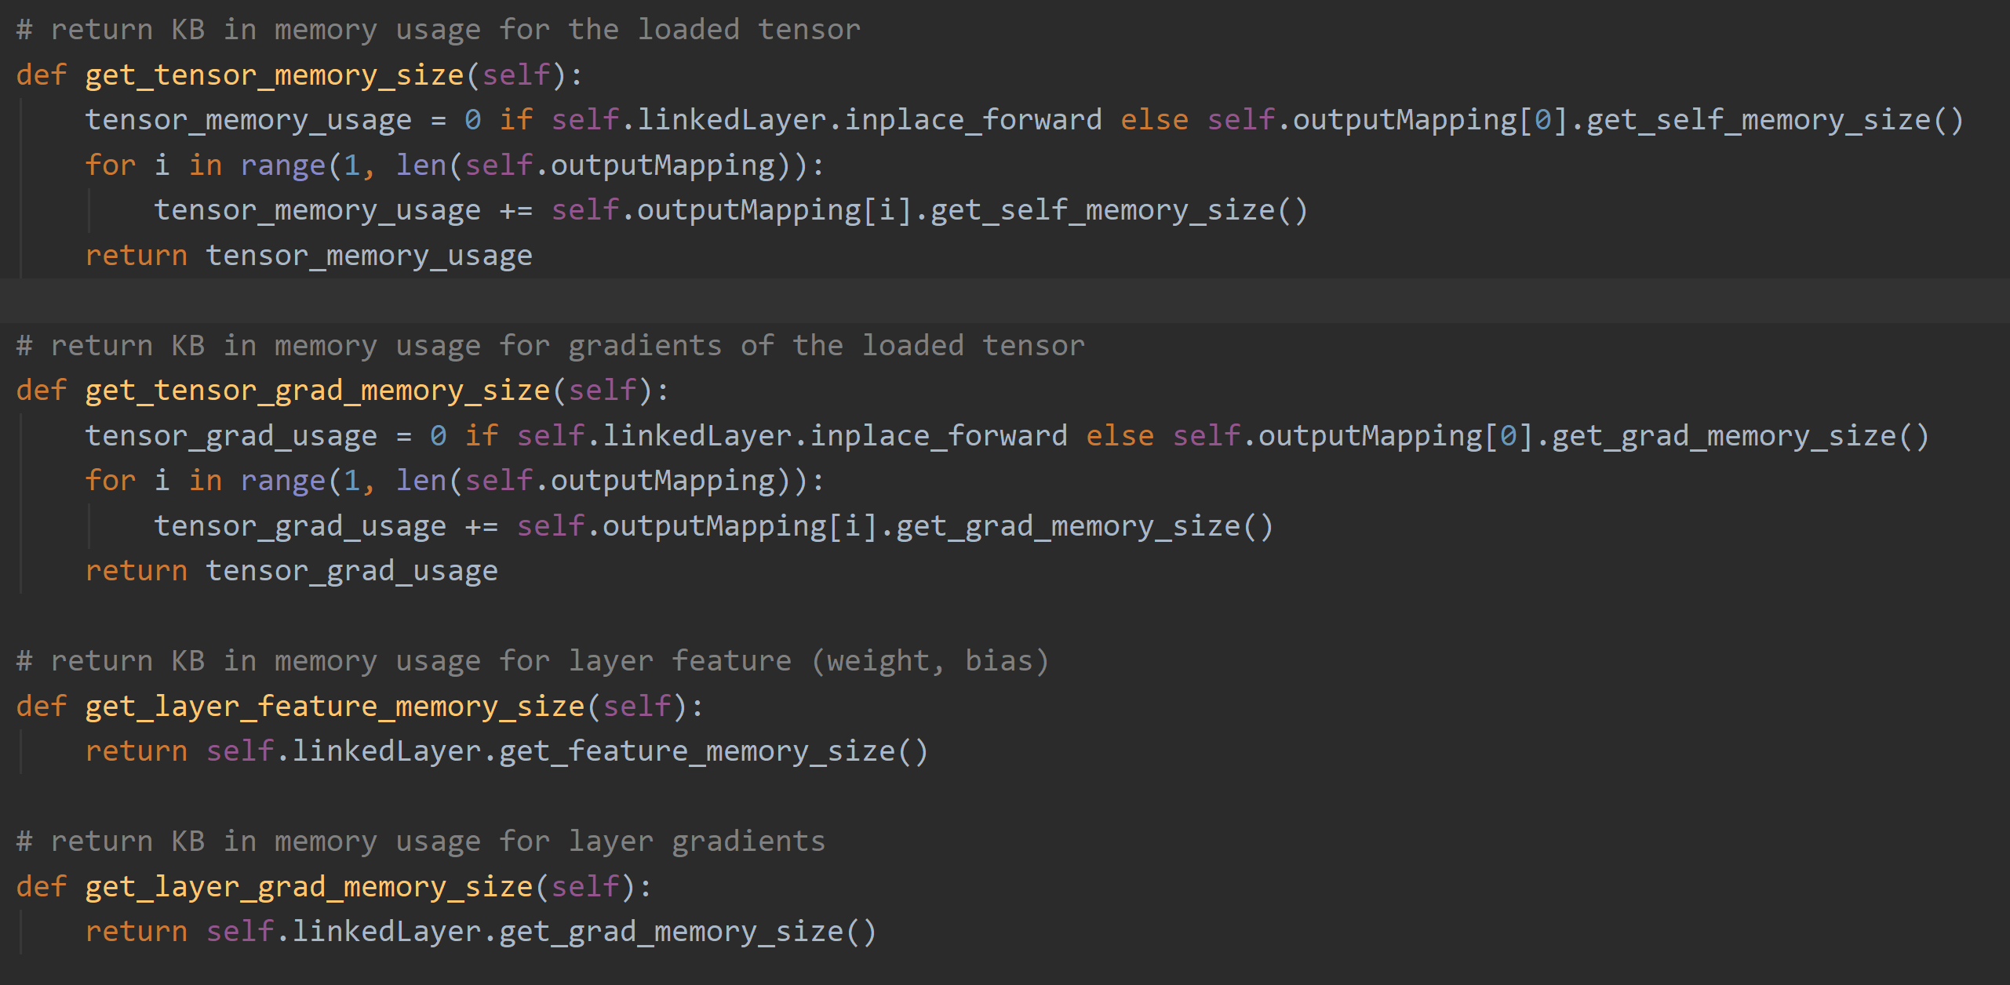
Status Update & Future Extension
Front end visualization and Interaction
Wrapped communication API
Backend code generation and model running
Bind PyTorch function and argument
On-training monitoring (block-based memory usage monitor)
Evaluation code generation (part)
Import pretrained model (vgg19)
Final demo:
Style Transfer Network
Handwritten Identification
1. Model (blocks)
2. Block (layer nodes)
3. Node (layer, optimizer, monitor, …)
4. Tensor

Slide 22
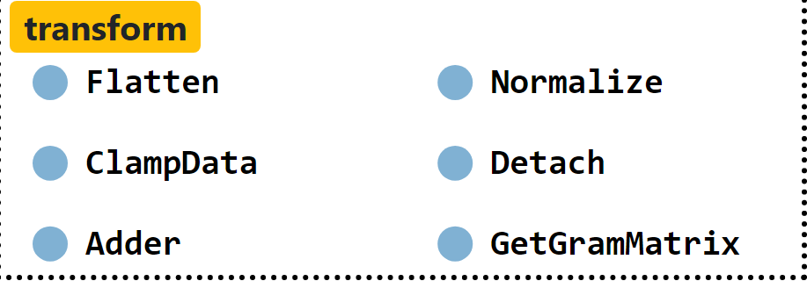
Future Extension
Add abstraction for more api in PyTorch (operation abstraction)
Support for distributed learning (hardware assignment)
Add possible exception handling mechanism and more warning
Add interface to support TensorFlow

Slide 23
Reference:
Azure machine learning studio. https://docs.microsoft.com/en-us/azure/machine-learning/studio. Accessed: 2020-03-25
Tensorboard. https://www.tensorflow.org/tensorboard/graphs. Accessed: 2020-03-25.
Skyline. https://github.com/geoffxy/skyline-atom. Accessed: 2020-03-25.
Paszke, Adam, et al. "PyTorch: An imperative style, high-performance deep learning library." Advances in Neural Information Processing Systems. 2019.
Elsken, Thomas, Jan Hendrik Metzen, and Frank Hutter. "Neural architecture search: A survey." arXiv preprint arXiv:1808.05377 (2018).

